Slide 1


EHEA Secretariat updates
Horia Onița, Head of Secretariat
XCIX BFUG meeting
Online, hosted by Cyprus
9th – 10th of March 2026

Slide 2
Supporting the meetings of the Working Structures since Copenhagen
14 meetings of the BFUG working structures
Setting up the Drafting Committee + ToRs and Roadmap
4 meetings in-person
Support in the organization of meetings (agenda, documents, liaison, practicalities)
19 other WS coordination meetings
Meeting minutes

Slide 3
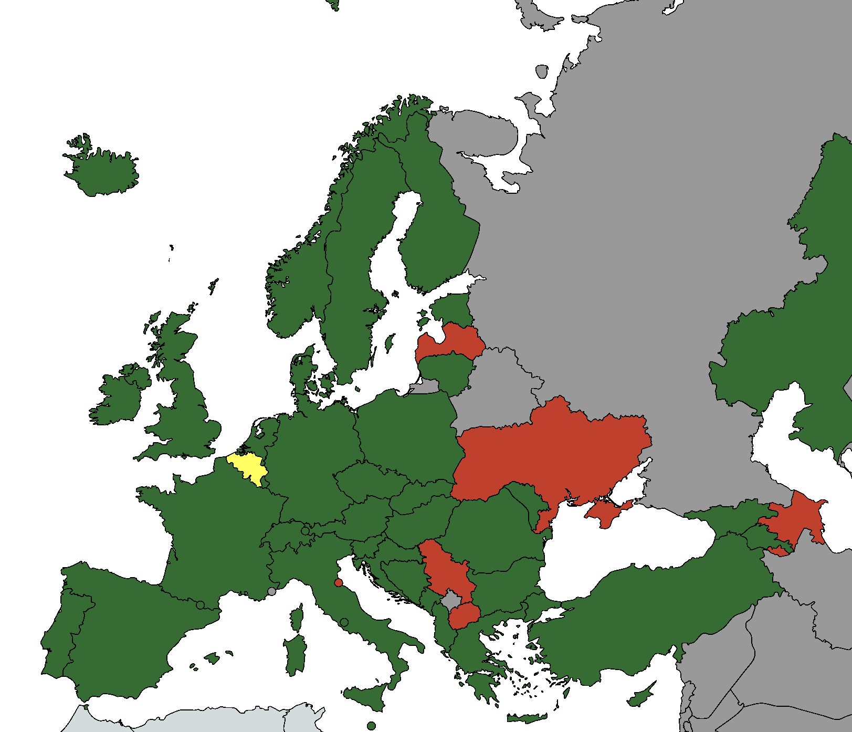
Situation of submitting the National Action Plans
By the XCIX BFUG meeting, the Secretariat received 42 out of 49 national action plans.
Plans missing from Azerbaijan, Belgium – Flemish Community, Latvia, North Macedonia, San Marino, Serbia, Ukraine.

Slide 4
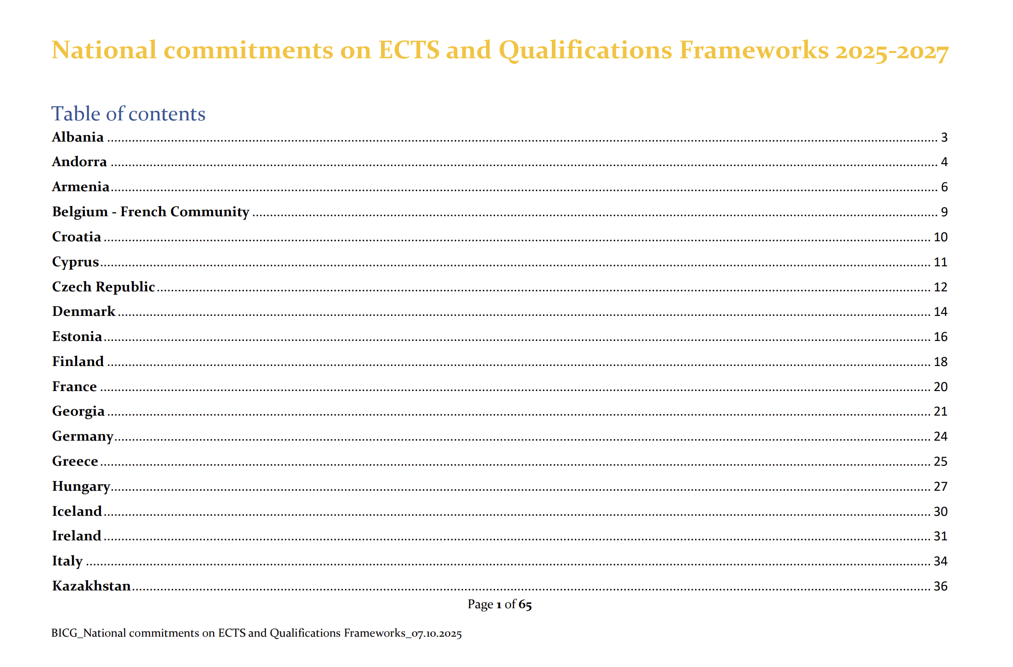
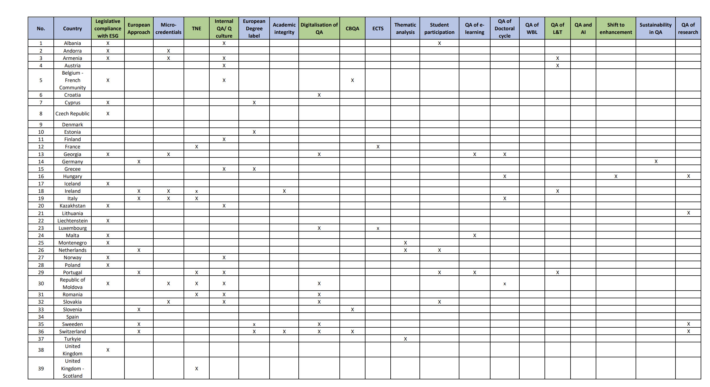
Compiling the data from NAPs
Uploading the NAPs on the EHEA website
Revising the tables
Review of the analysis between BPIR 2024 and NAPs – in progress

Slide 5
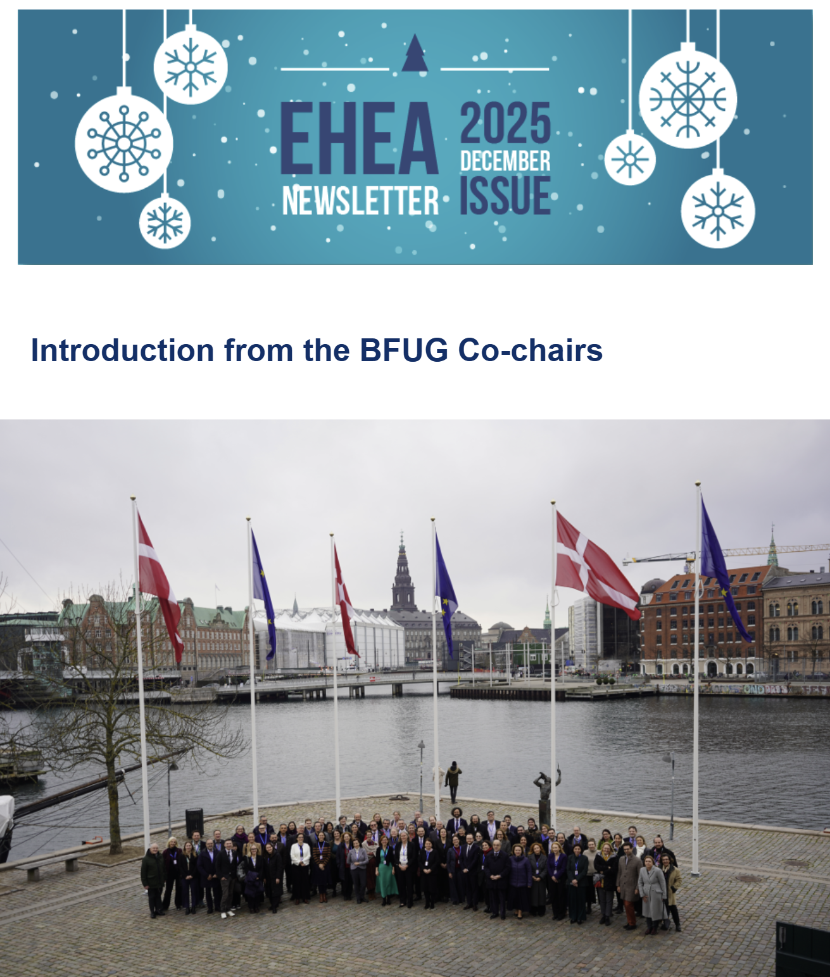
EHEA Newsletter December 2026
16 articles
Articles on ESG, ECTS
National developments from Andorra, Austria
Project updates – TPG A, TPG C, BHPS by DAAD
Updates fron ENQA, CoE, EAIE, ASEM Secretariat, EURASHE
Expert contribution on LRC

Slide 6
EHEA Newsletter June 2026
Guidelines here
Deadline for contributions: 5th of June 2026
Promoting the activities of the WS
Don’t forget to subscribe!

Slide 7
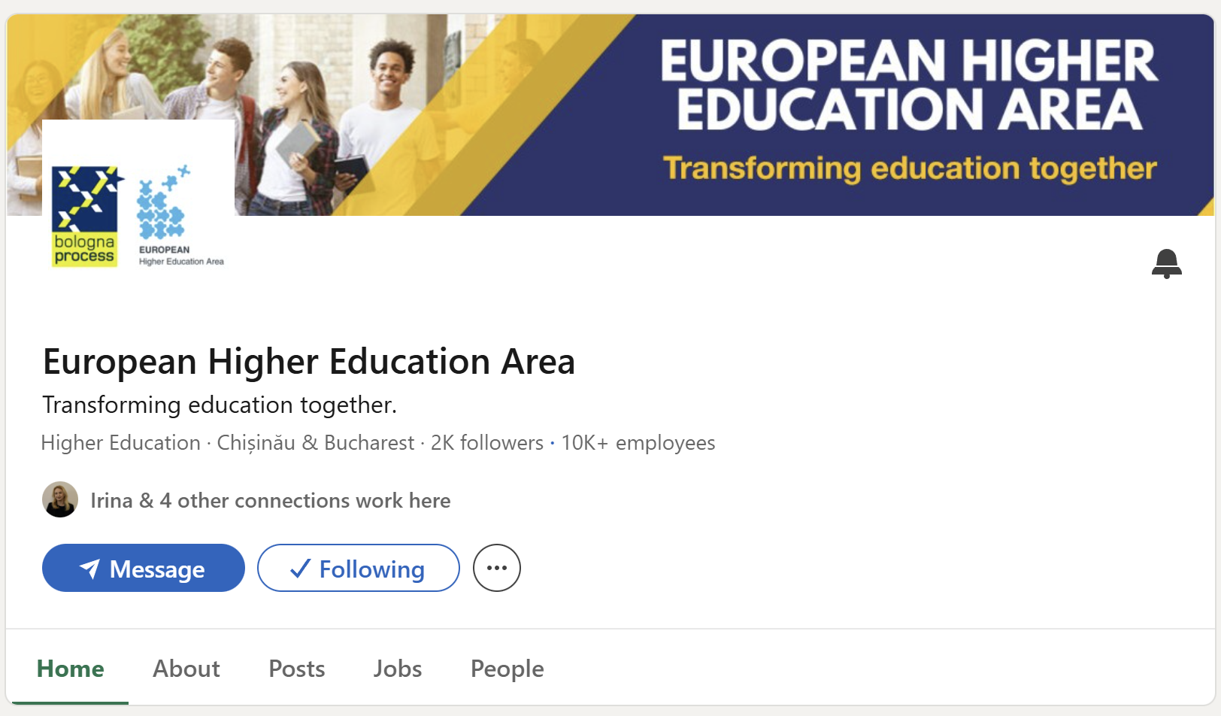
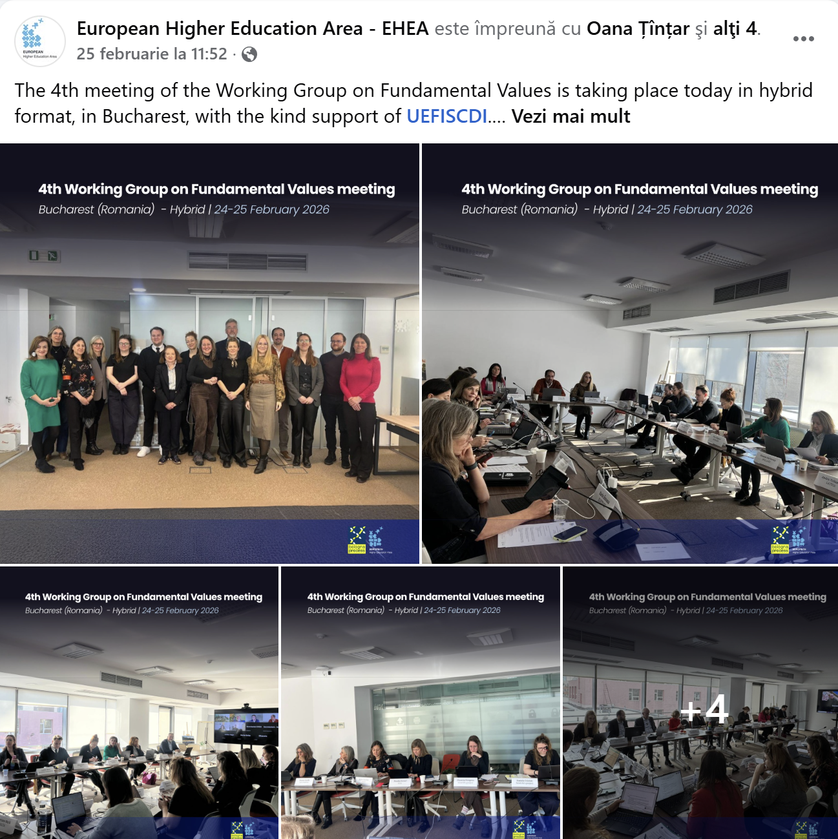
Social media mid-term report
Over the reporting period (September 2024 – February 2026), the EHEA Secretariat published a total of 132 posts across three platforms — Facebook (50), Instagram (33), and LinkedIn (49).
The combined reach exceeded 150,000 views/impressions, generating over 19,000 engagements and 3,600+ reactions.
LinkedIn emerged as the strongest engagement driver with an average engagement rate of 23.4%.
Peak performance months were November and December 2025

Slide 8
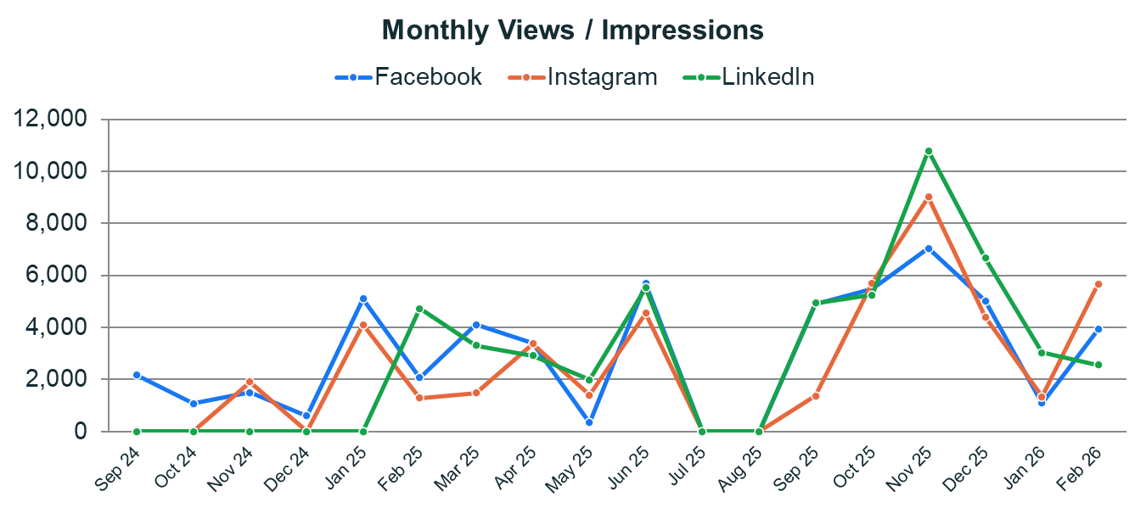

Slide 9
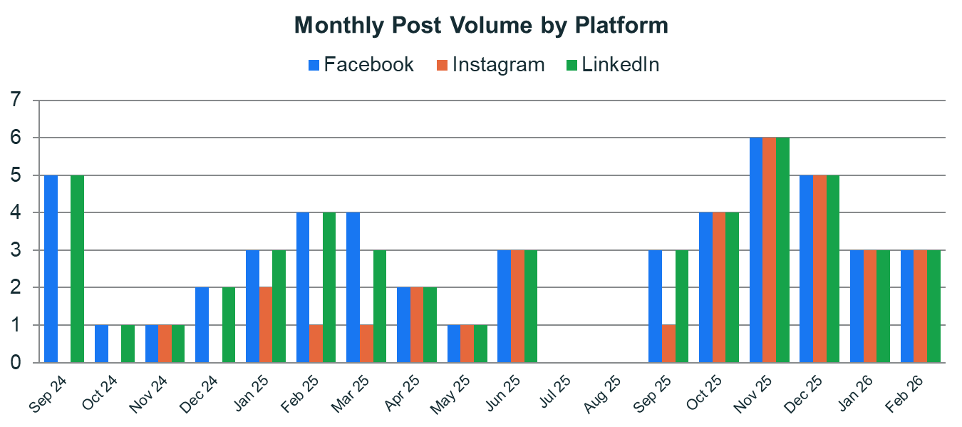

Slide 10
Social media mid-term report
Average 1400 views/post
Increase of over 3x for reach and audience

Slide 11

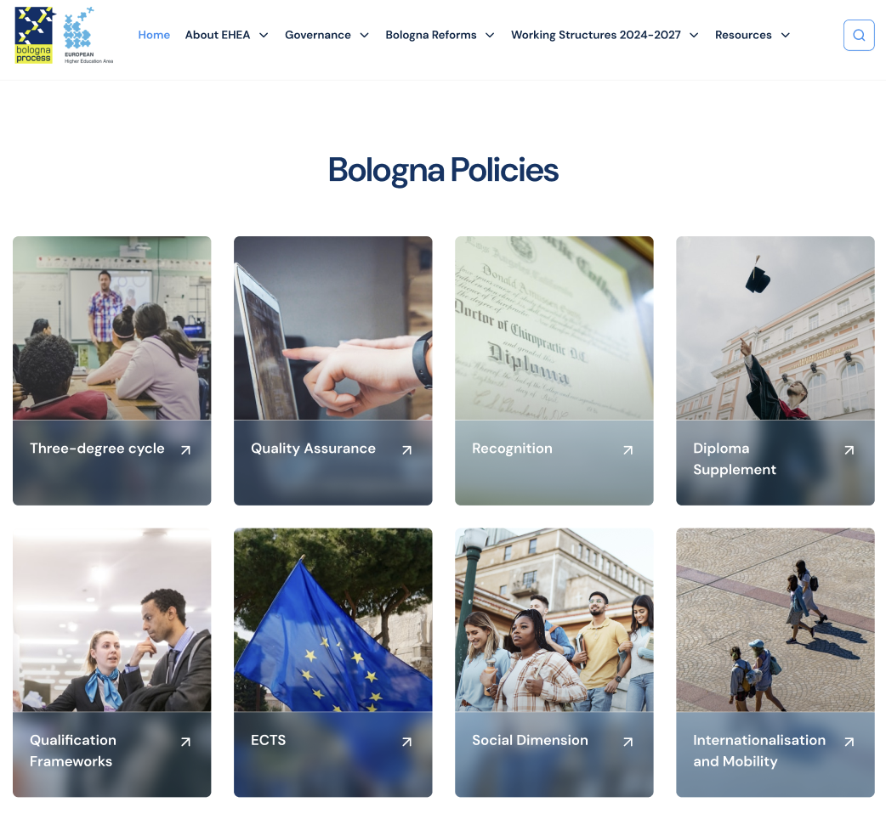
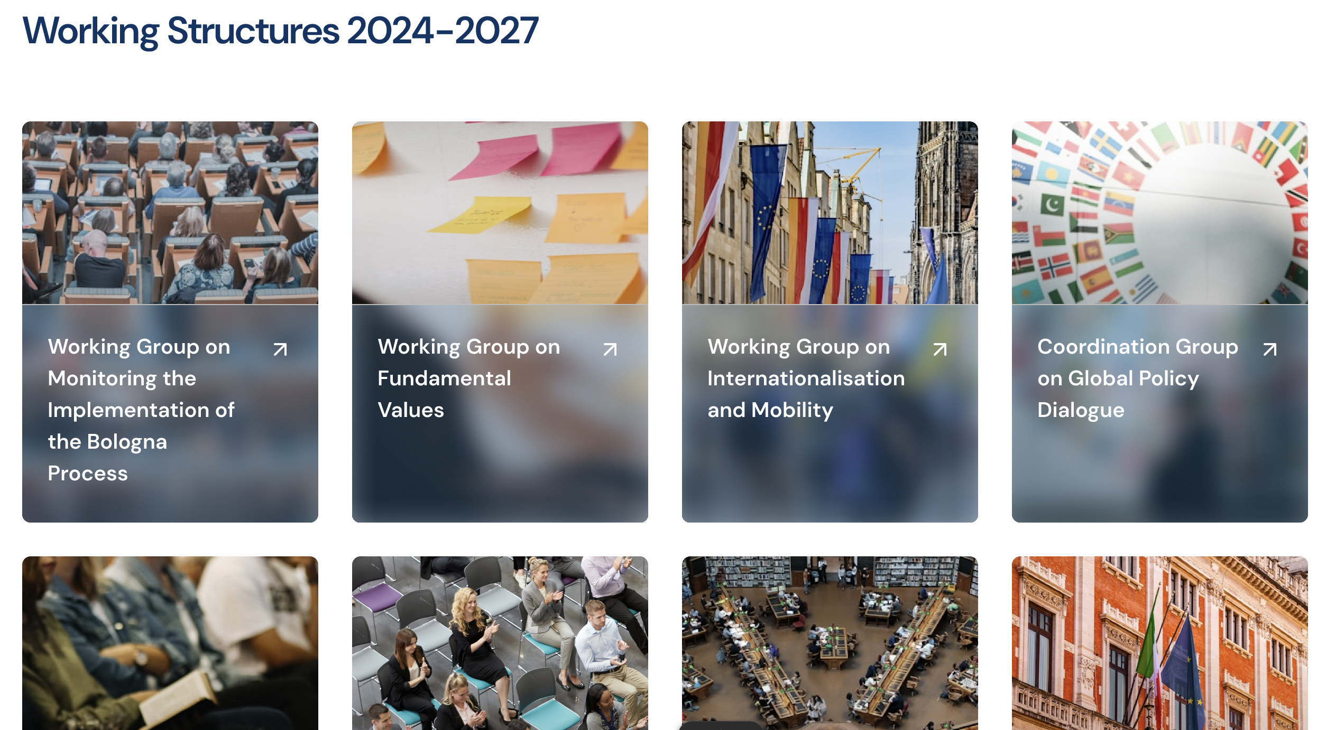
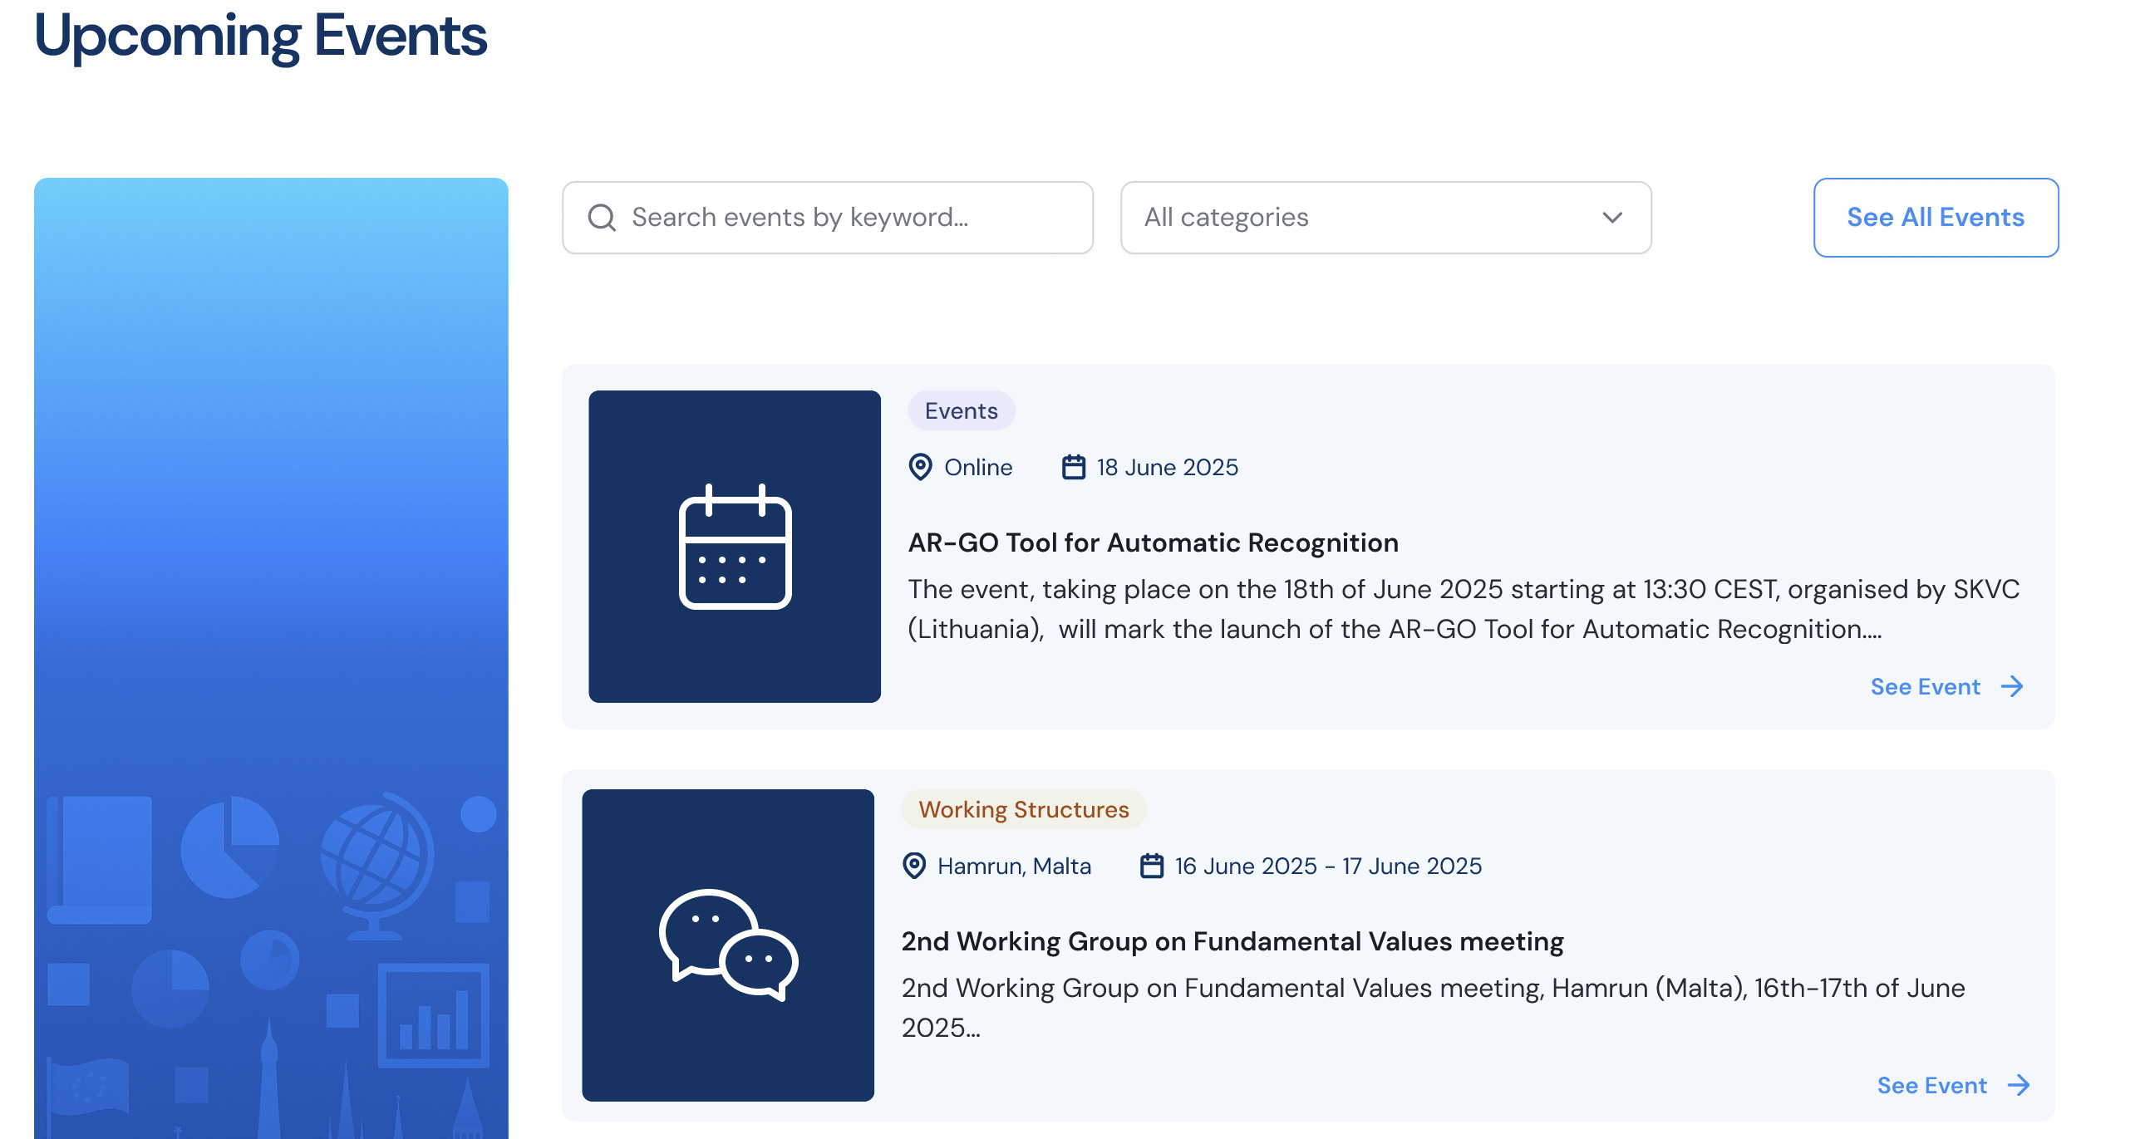

Slide 12
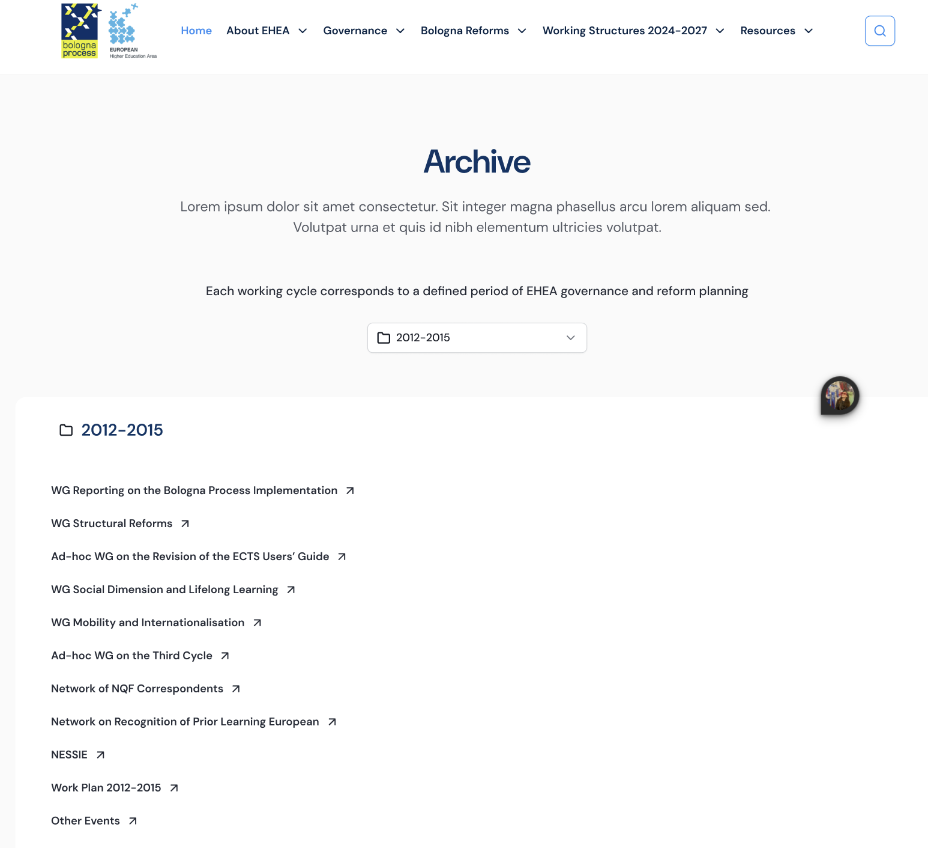
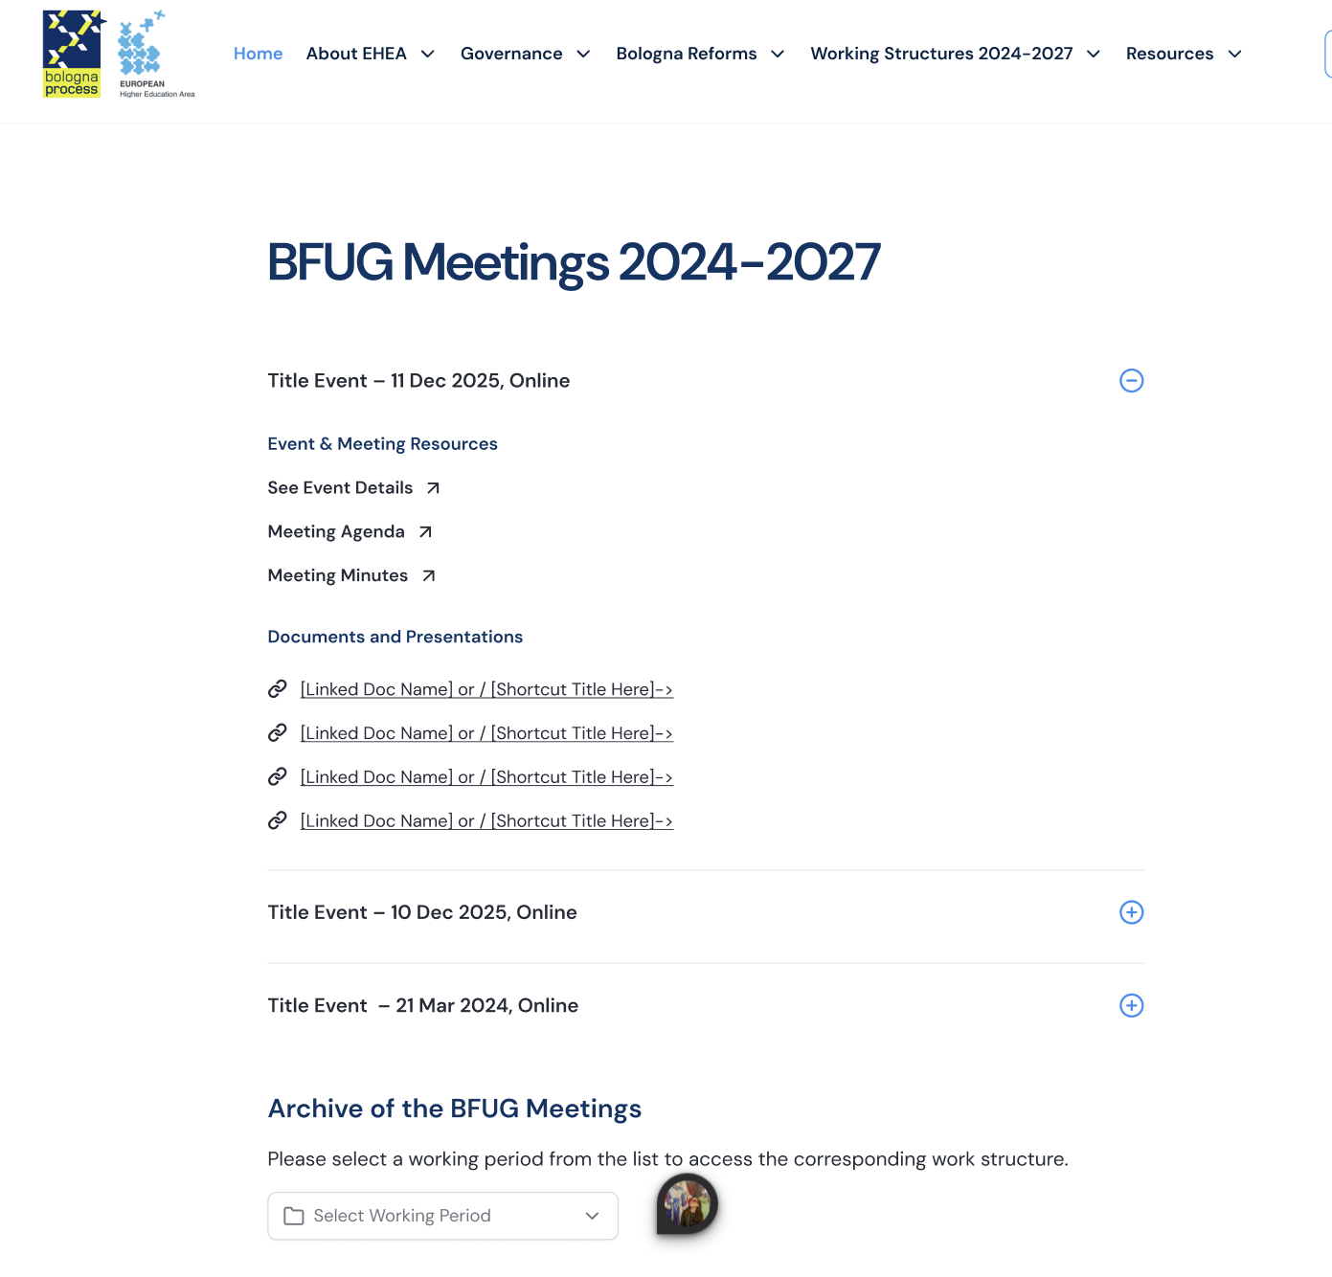
Website – new.ehea.info

Slide 13
Website – new.ehea.info
Migration – 11 & 12 March 2026
Presented + feedback at the Board
Please review your country/organisation page
WS will be asked to further review their Bologna topics pages
Latest meetings to be uploaded on a rolling basis

Slide 14
Other activities conducted by the Secretariat
ESG public consultation analysis with EQAR
Supporting the TF LT Sec in the process & procedure
01.
02.
Communication for FV – National operators and BPIR
Coordination with the hosts of the Ministerial Conference
02.
04.

Slide 15
Secretariat’s team and supporting project
1 HoS, 1 Deputy HoS
4 members + 1 Comms Expert
Team
Weekly online meetings
1 in person meetings (RO)
Erasmus+ project
Based on Secretariat’s ToRs
Project
Conference on EKS/FoB – Sept 2026
Small study on the impact of BP

Slide 16
EHEA Secretariat updates
Horia Onița, Head of Secretariat
XCVIII BFUG meeting
Copenhagen, Denmark
15th – 16th of December 2026

